Slide 1
Gender and Age Classification on Blog Authorship Corpus
Sagar Damani (ssd2144)
Samarth Tripathi (st3029)

Slide 2
Blog Authorship Corpus
19k bloggers with over 600k posts (Blogger.com)
Over 140 million words
Age and gender labels:
Age: ~8k “10s“, ~8k “20s“, ~3k ‘30s+‘
Gender: Equal male-female blogs
Objective
Author profiling
Deep Learning vs Other Classification techniques

Slide 3
Features Extracted
LIWC
Frequent unigrams (1000 with highest information gain)
POS tags (unigram, bigram)

Slide 4
Classifier Results
Gender:
LDA: 79.53%
XGBoost: 76.8%
Logistic Regression: 76%
Age:
LDA: 74.32%
XGBoost: 72.06%
Logistic Regression: 70.3%

Slide 5
Most Important Features for Gender
Male:
High Analytic/Clout
Longer words, more words per sentence
More articles, prepositions
Female:
More pronoun usage
Higher affect
High Authentic

Slide 6
Most Important Features for Age
Younger (10s):
Netspeak, informal
Filler
Swearing, exclamation
Older (20s/30s):
High Analytic
More “work” content
Longer words, more words per sentence

Slide 7
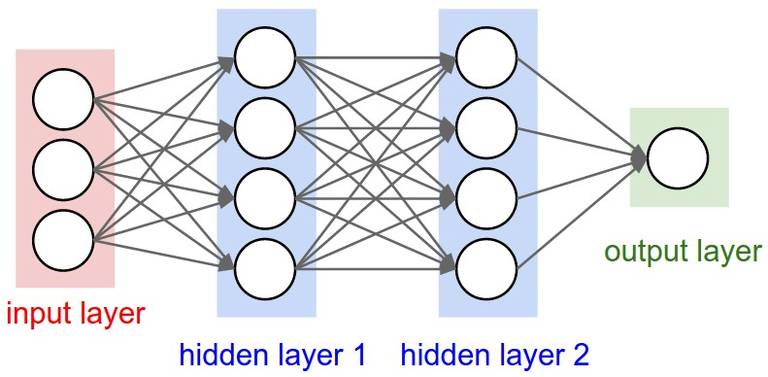
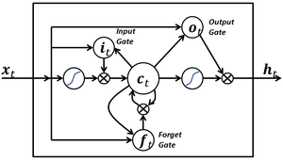
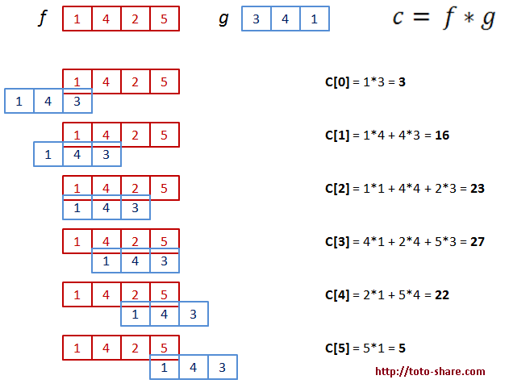
Deep Learning Architecture
Three Approaches –
1) Feed Forward Network, using Sagar’s Features
2) Ensemble Network using only the Text Posts
3) Combined architecture using 1 and 2
Data Split –
75% Training,
15% Validation,
10% Test
Feed Forward Network
LSTM Unit
1D Convolution

Slide 8
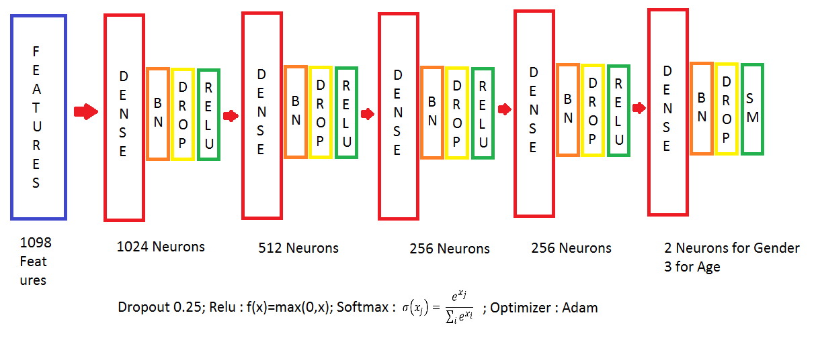
Deep Learning Architecture - 1

Slide 9
Deep Learning Results - 1
Approach | Gender Classification | Age Classification
Baseline | 50% | 43.8%
Schler et. al. | 80.1% | 76.2%
Sagar’s Approach | 79.53% | 74.3%
Approach1 (Validation) | 79.92% | 76.24%
Approach1 Test | 79.14% | 76.6%

Slide 10
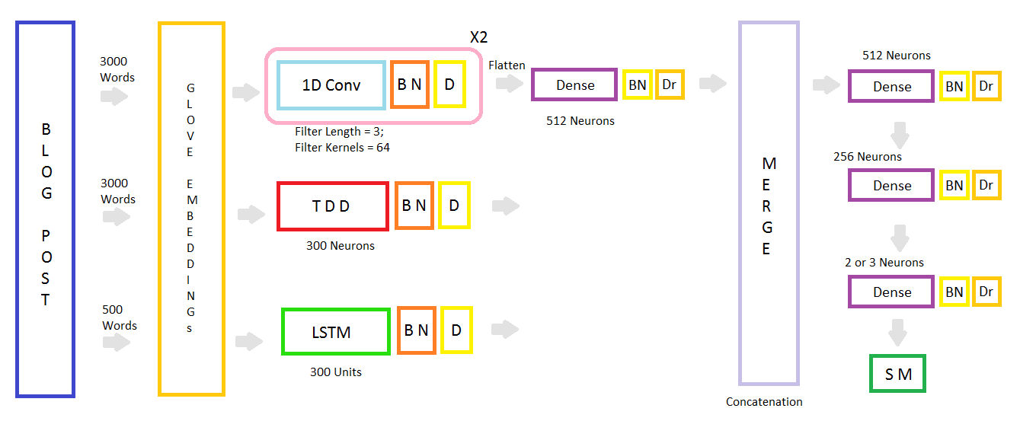
Deep Learning Architecture - 2

Slide 11
Deep Learning Results - 2
Approach | Gender Classification | Age Classification
Baseline | 50% | 43.8%
Schler et. al. | 80.1% | 76.2%
Sagar’s Approach | 79.53% | 74.3%
Approach1 Test | 79.14% | 76.6%
Approach2 Validation | 77.62% | 73.97%
Approach2 Test | 78.4% | 76.34%

Slide 12
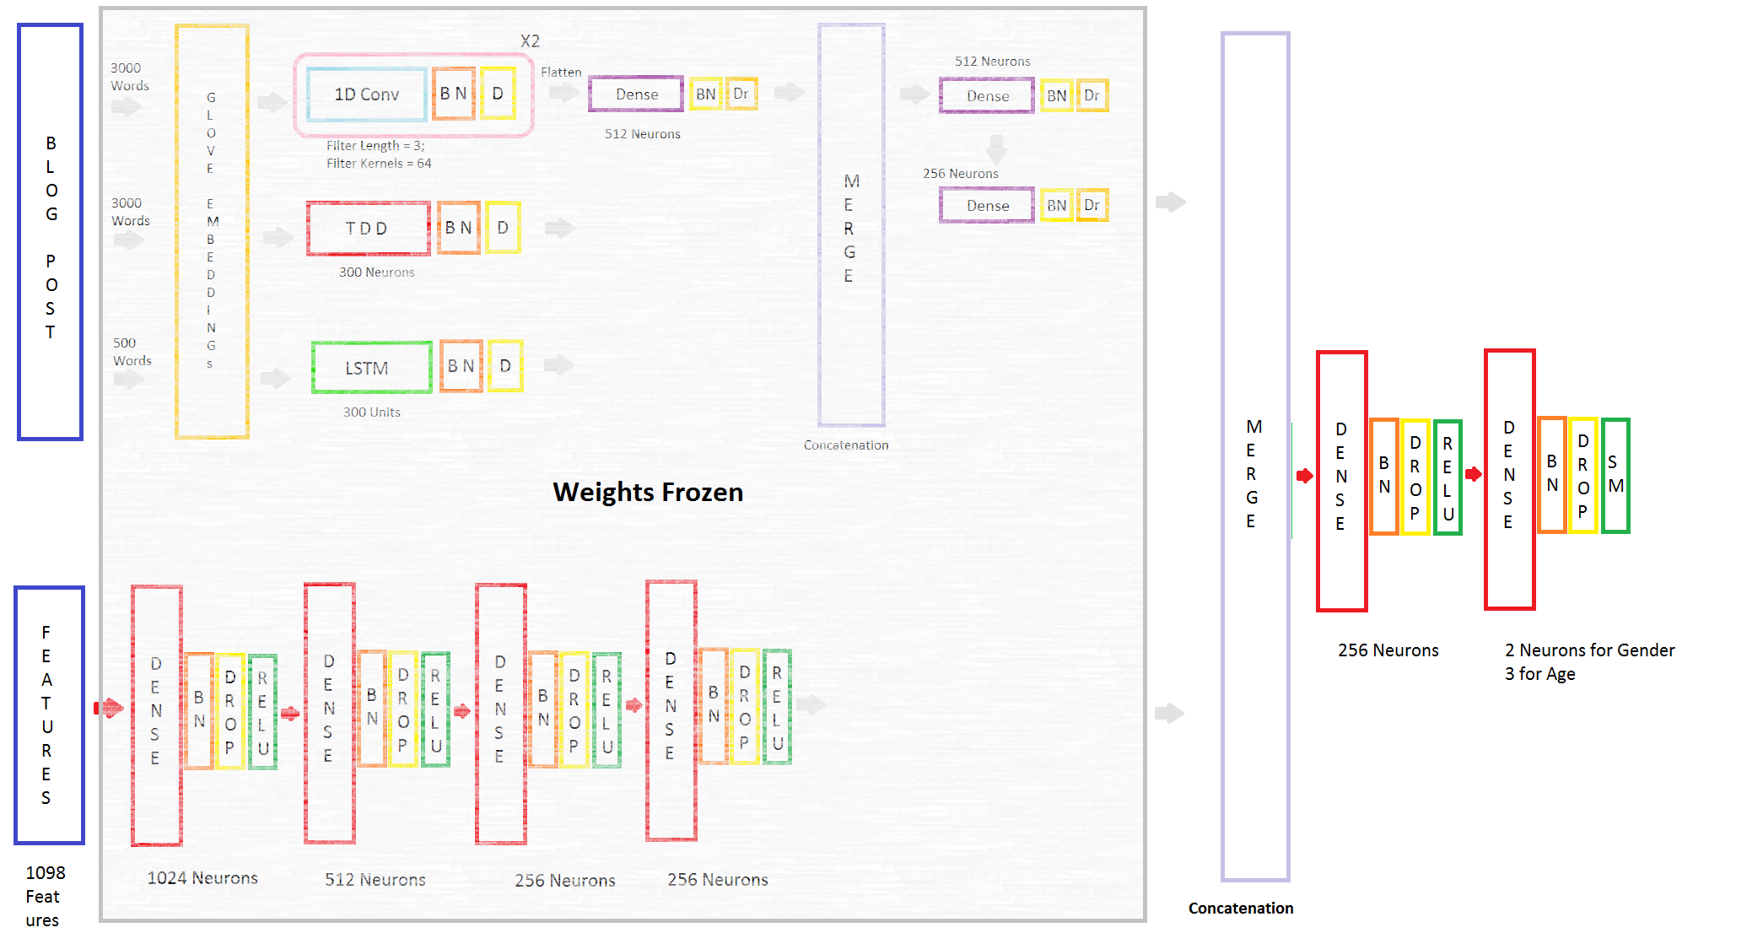
Deep Learning Architecture - 3

Slide 13
Deep Learning Results - 3
Approach | Gender Classification | Age Classification
Baseline | 50% | 43.8%
Schler et. al. | 80.1% | 76.2%
Sagar’s Approach | 79.53% | 74.3%
Approach1 Test | 79.14% | 76.6%
Approach2 Test | 78.4% | 76.34%
Approach3 Test | 80.6% | 76.96%

Slide 14
Analysis and Future Work
Challenges:
Only a small rise in accuracy when combining models indicates both models are detecting almost the same features and so cannot complement each other
Training approach 2 on more than 3000 words (and just 500 for LSTM) should give a better analysis and in turn improve approach 3, but training time overhead is too high

Slide 15
THANK YOU

